Slide 1
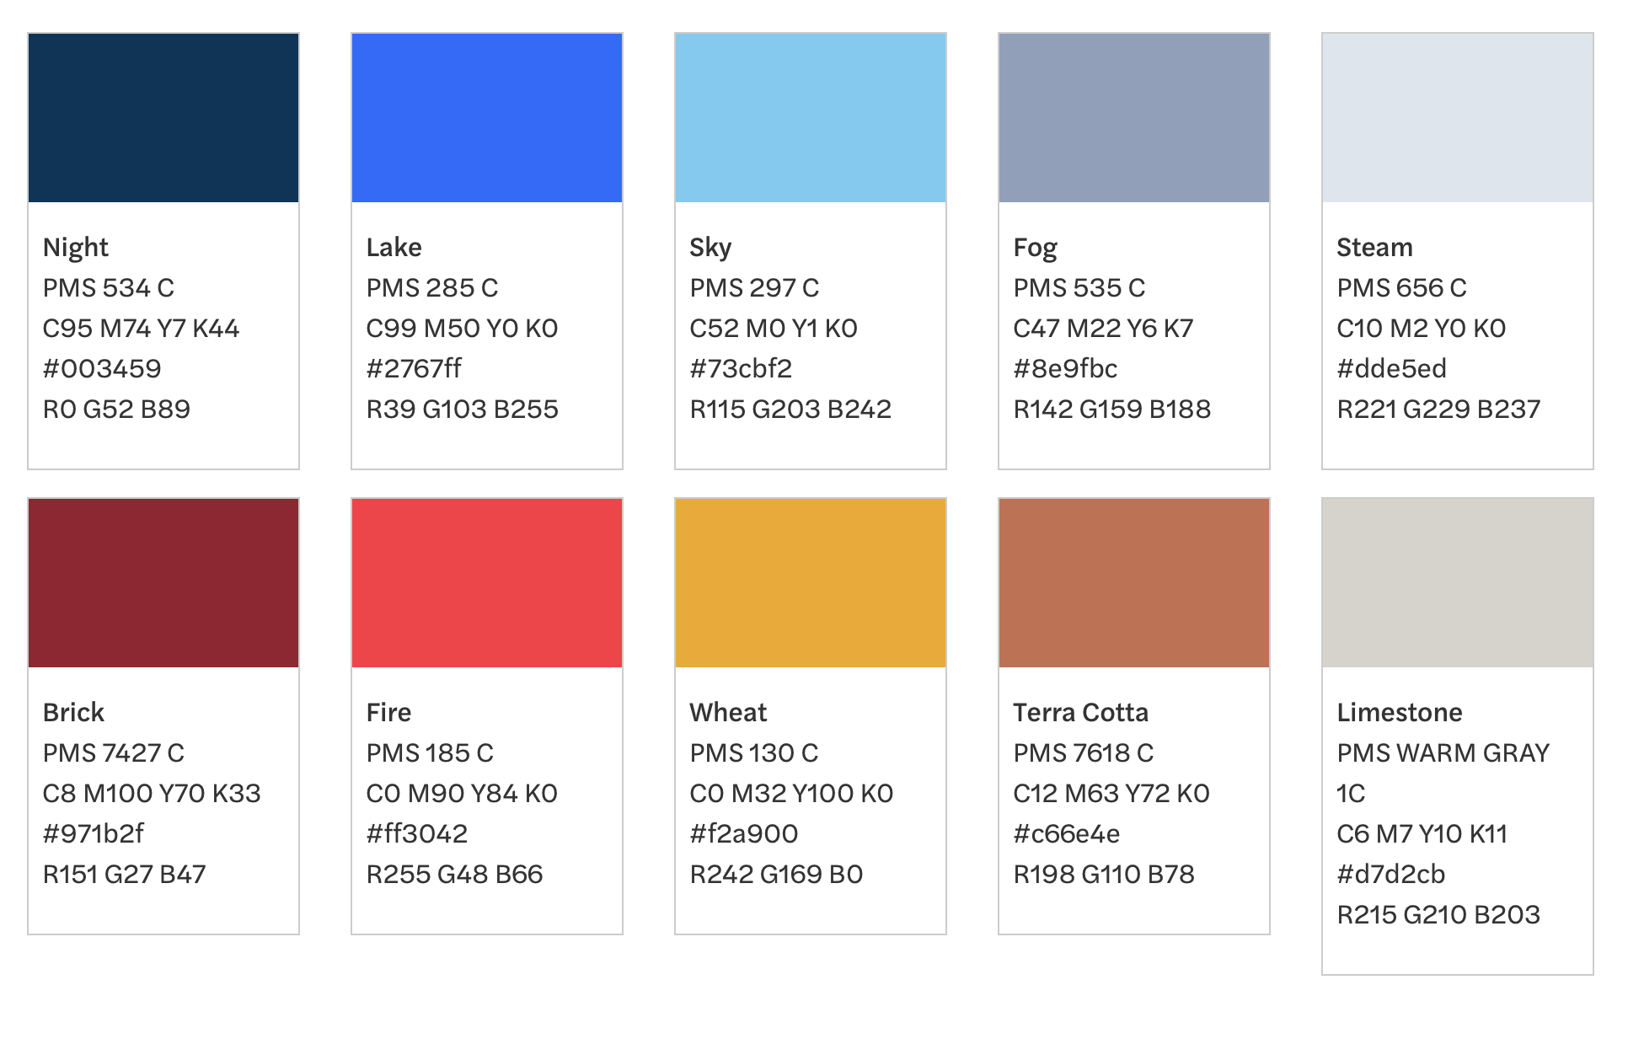
Title 1

Slide 2
Title 2

Slide 3
Title 3

Slide 4
Title 4

